Slide 1




Enhancing Flash Flood Warnings in Johnson County, Texas: A Multidisciplinary Approach to Risk Thresholds and Communication
Jamie Moore, Johnson County, Emergency Management
Brenda Philips, University of Massachusetts, Amherst
Eric Adams, TxSense

Slide 2
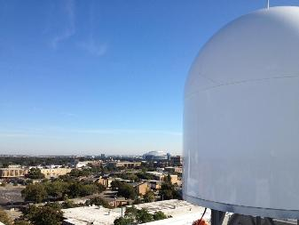
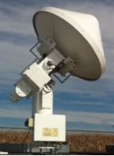
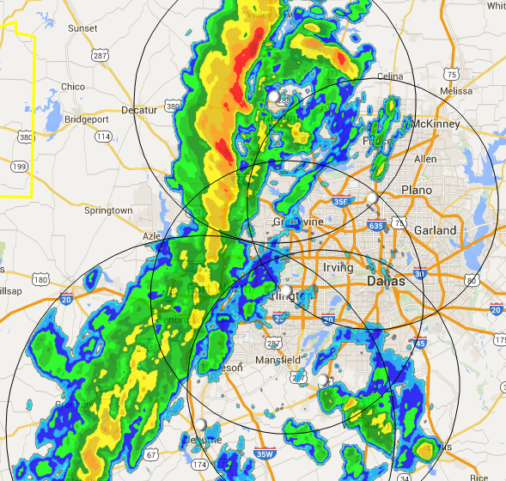
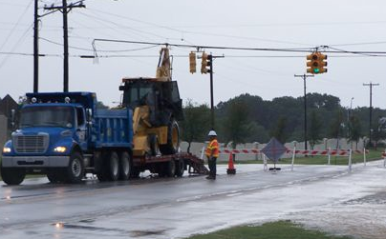

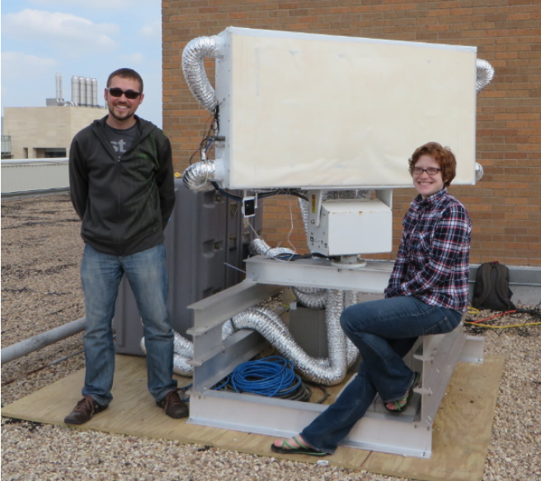

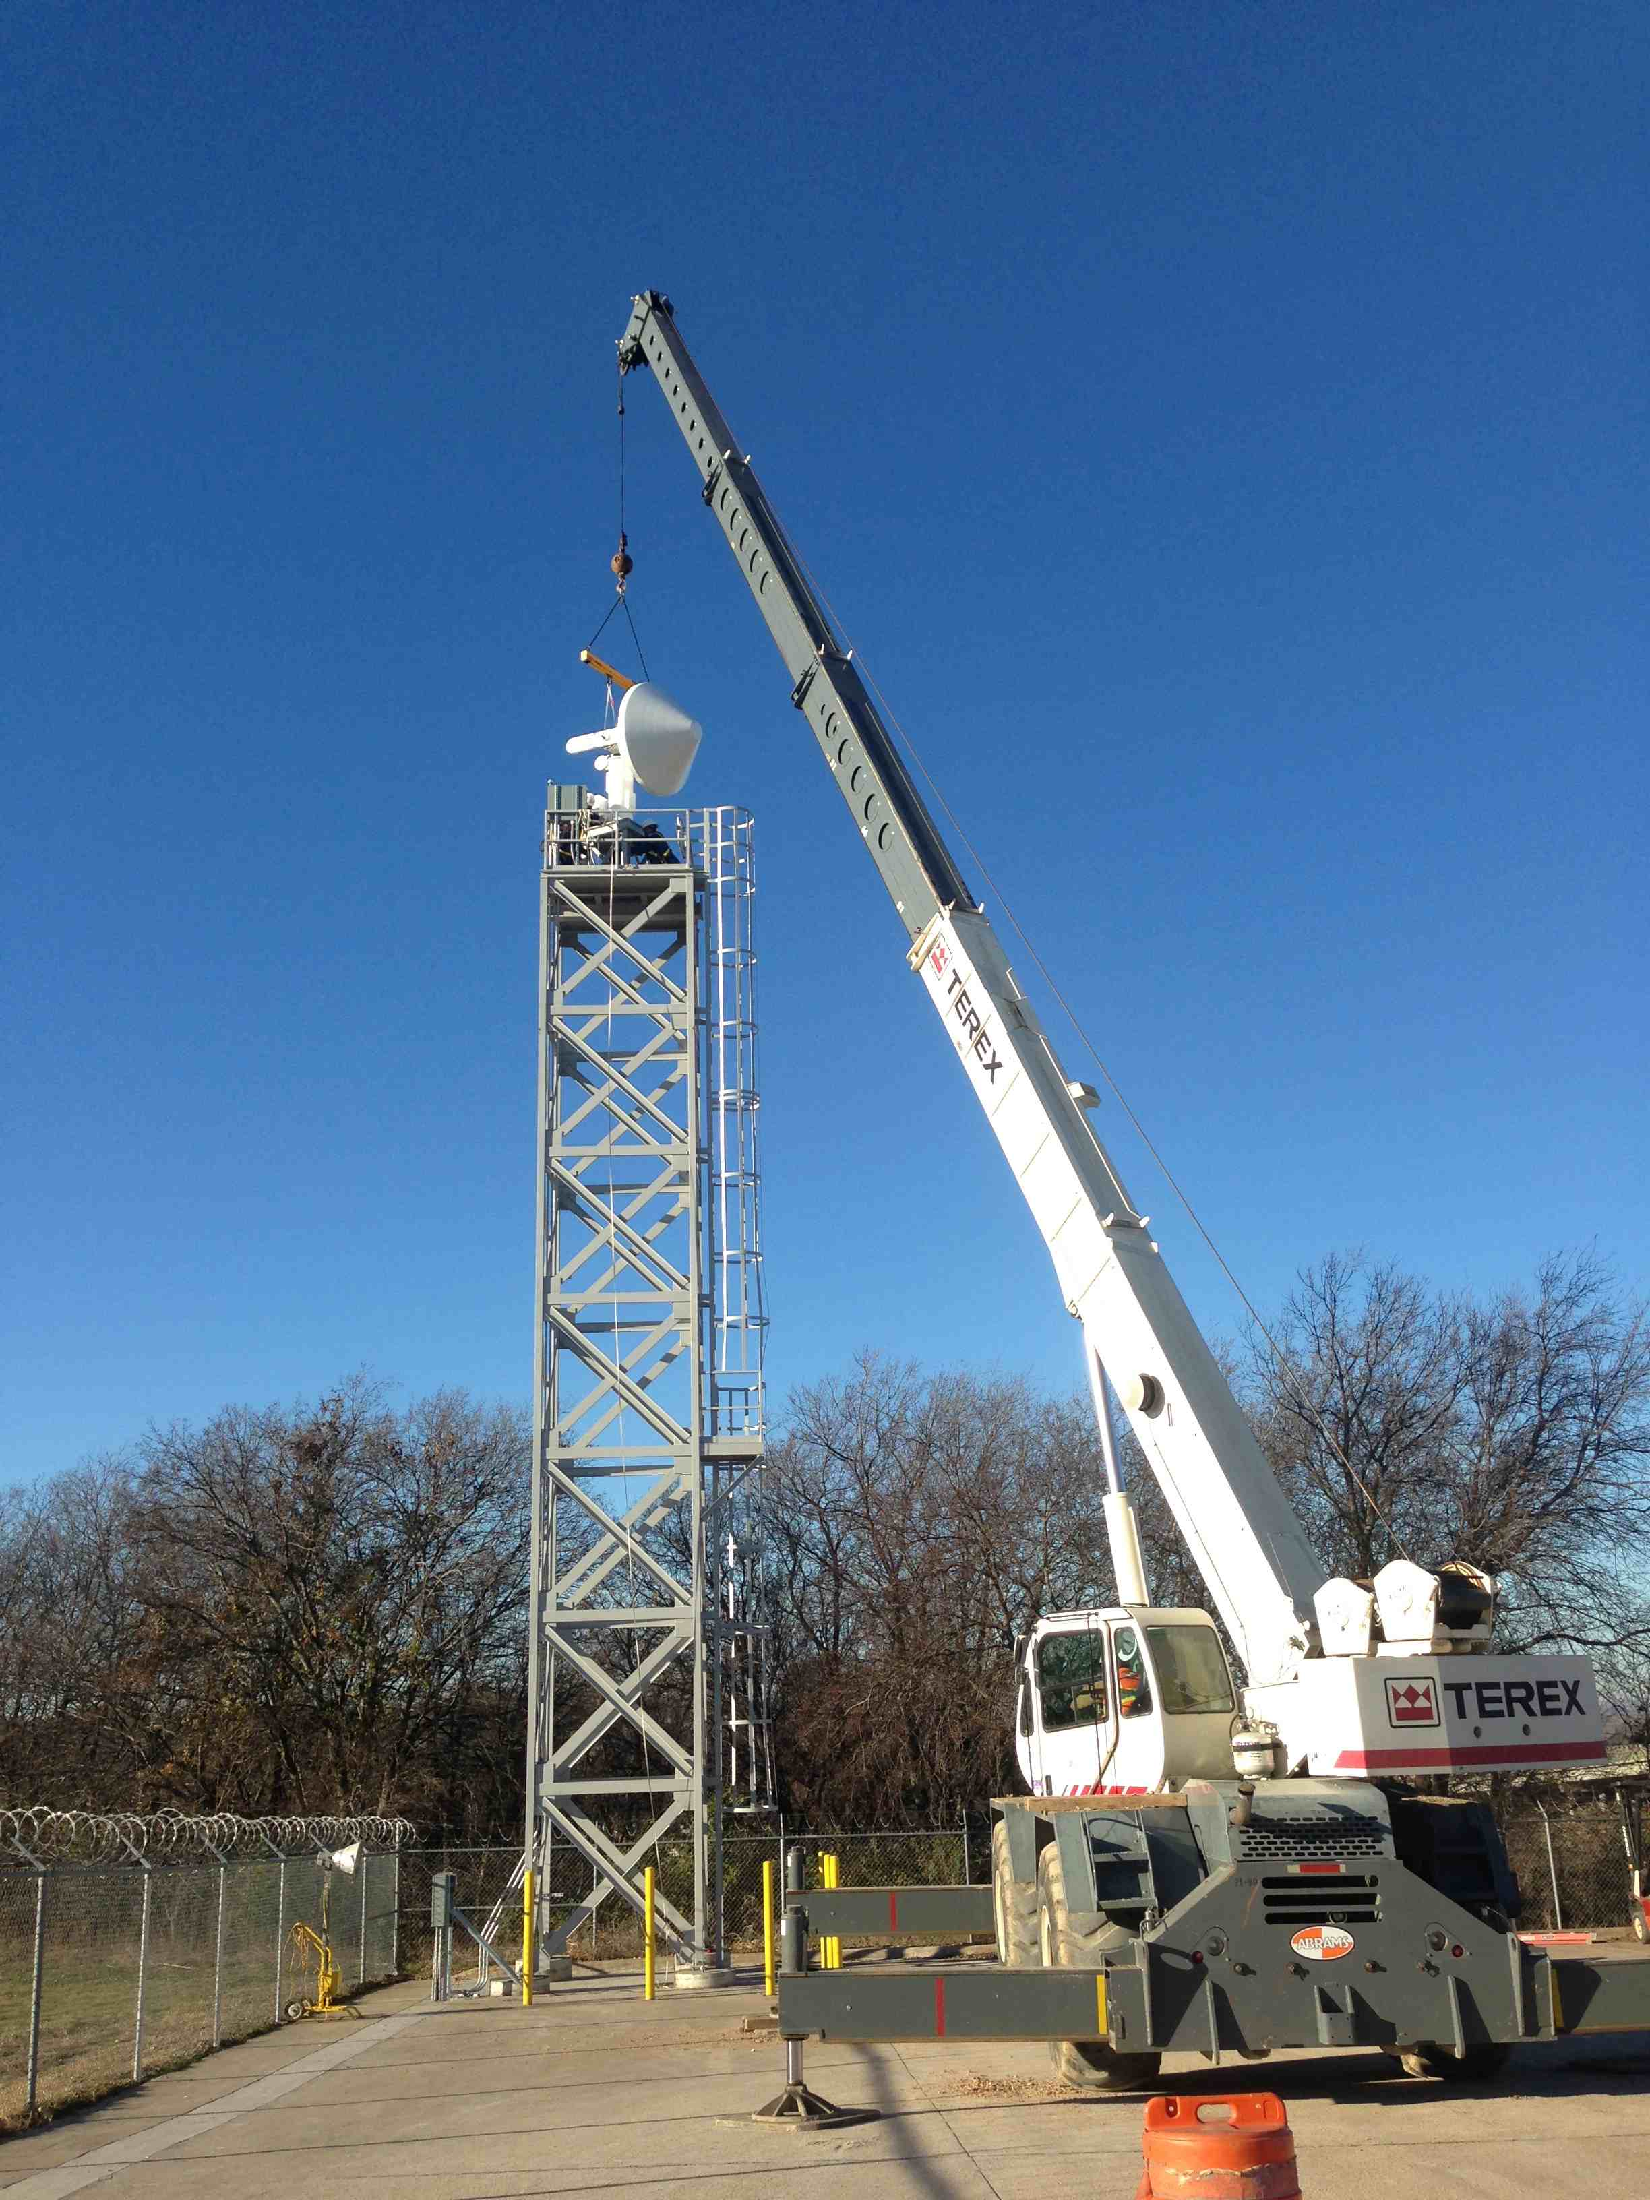
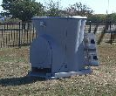

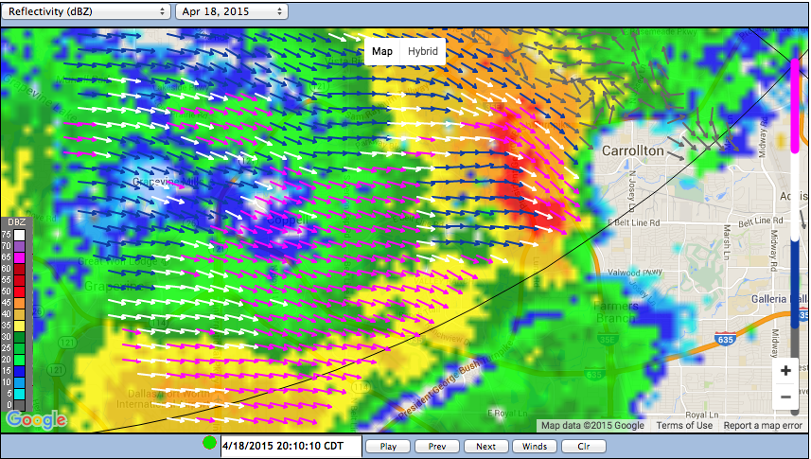
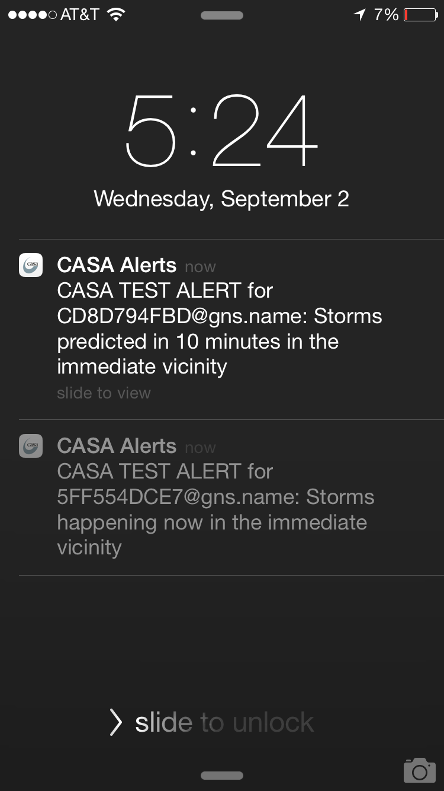
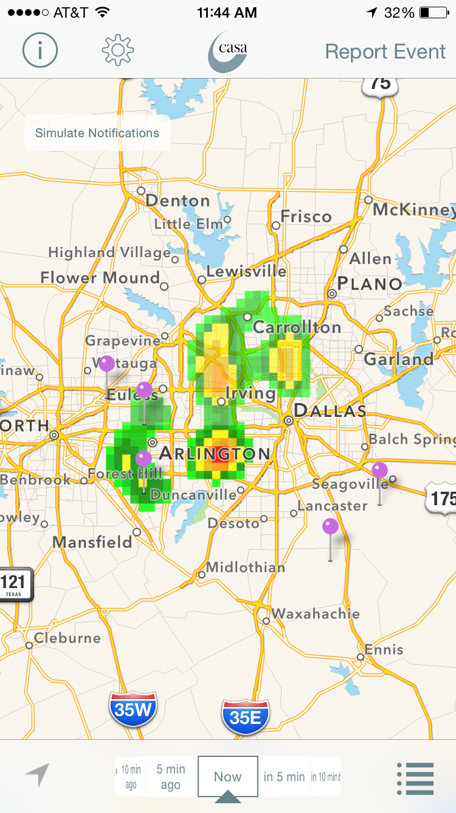
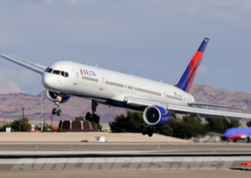

Severe Weather Warning System
Multi-Sector Partnership: North Central Texas Council of Governments, EMs, UMASS, CSU, NWS Fort Worth
SENSORS
PRODUCTS
USERS
Notes:
CASA isn’t just radars, it’s the full warning system from sensors, to products and displays and data out to different users. It’s run as mutltiscector partners going on 13 years…
Where local communities host radars and pay membership fees that cover radar operations. The academic partners get grants to cover additional research. (Say that Johnson County hosts a radar.

Slide 3
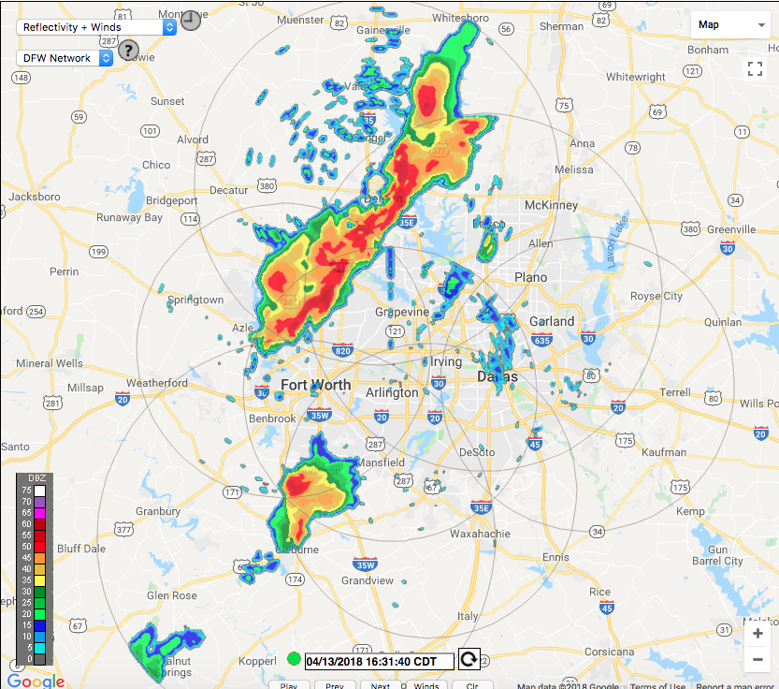
Collaboration through CASA DFW Living Lab
24/7 Operations Research
X-band CASA Radar Network
Lower atmosphere observations
Fine-grained, neighborhood-scale data
60 second updates to track fast-moving storms
Customized products
CASA network covers approximately 32,000 sq. km. Radar range is 40 – 100km. Overlapping coverage improves data quality
Notes:
Here to talk about a collaboration with the CASA program. It’s a network of radar the operated 24/7 providing data to stakeholders including the NWS Fort Worth for real time decision-making. CASA data is fine scale, rapidly updatable and flexible for EM needs. It’s also a research platform for advancing warning systems.

Slide 4
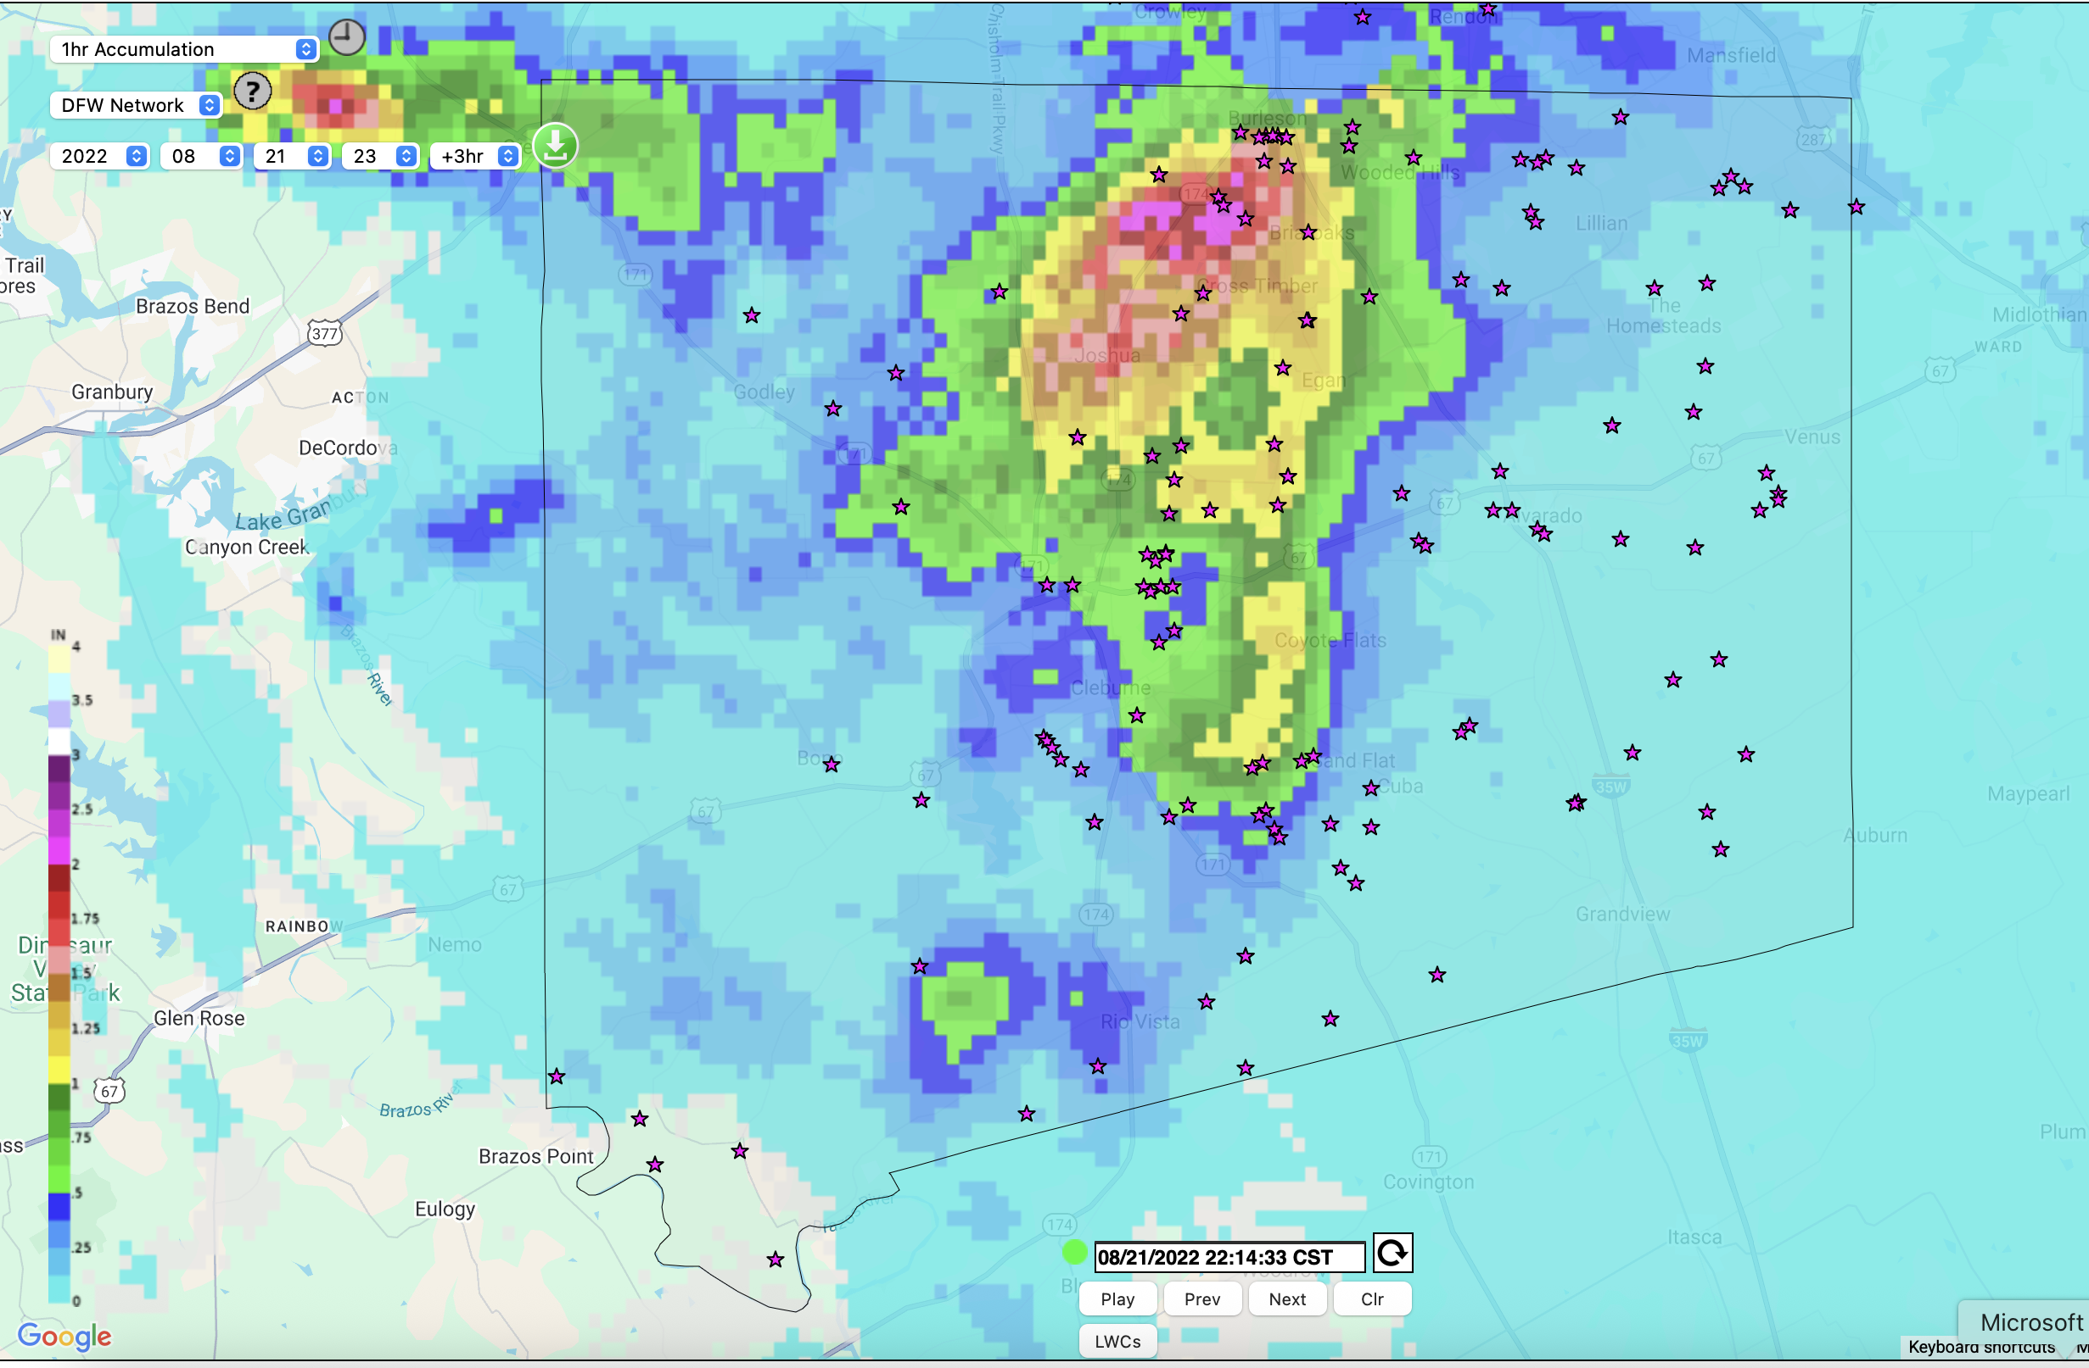
CASA Rainfall Products (QPE)
Dual Pol
500 meter, 1-minute updates
Low-latency
Accurate radar-only measurements
Integrates WSR88D and CASA radar data
Flexible products

Slide 5
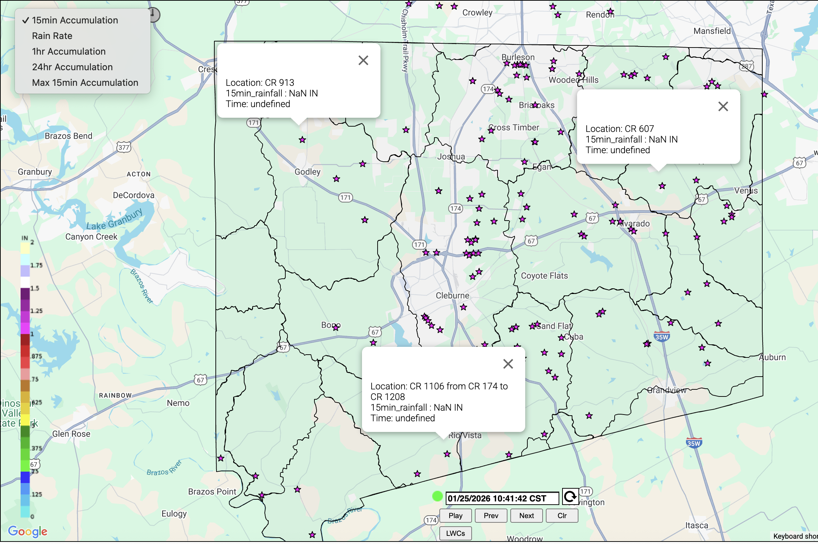
Johnson County Website for Evaluating Flood Risk
Real-Time Interface
Accumulates Rainfall over
  LWCs
  Watersheds
Alerts to key stakeholders when rainfall accumulation reaches thresholds?
What are the thresholds

Slide 6
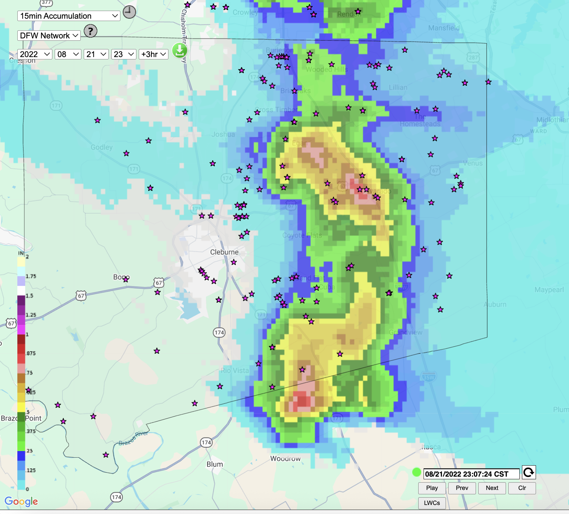
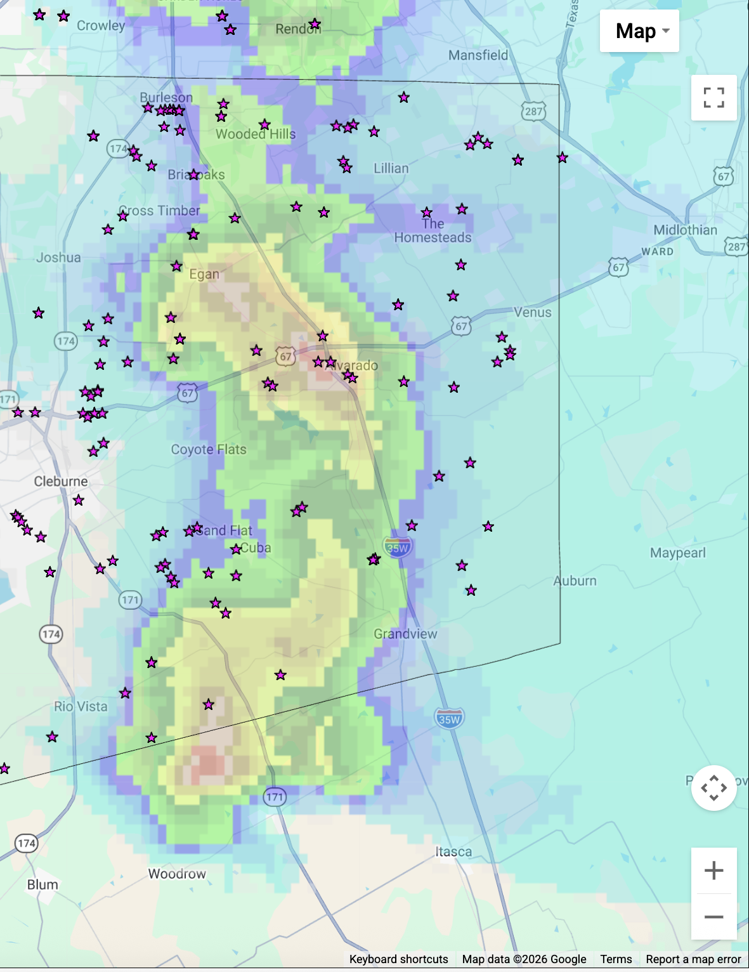
August 22, 2022 Historic Flash Floods: 15 min. Rainfall
.8 inches

Slide 7
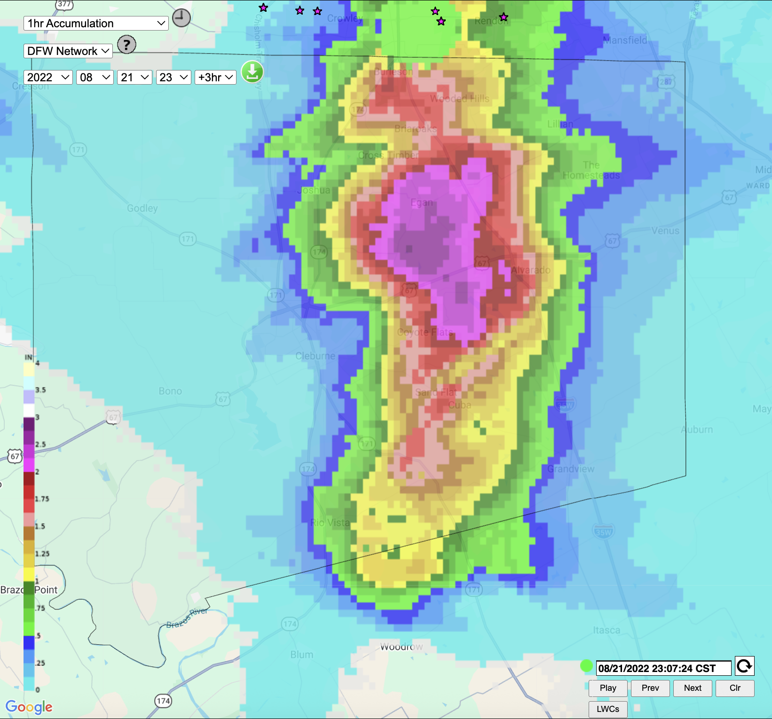
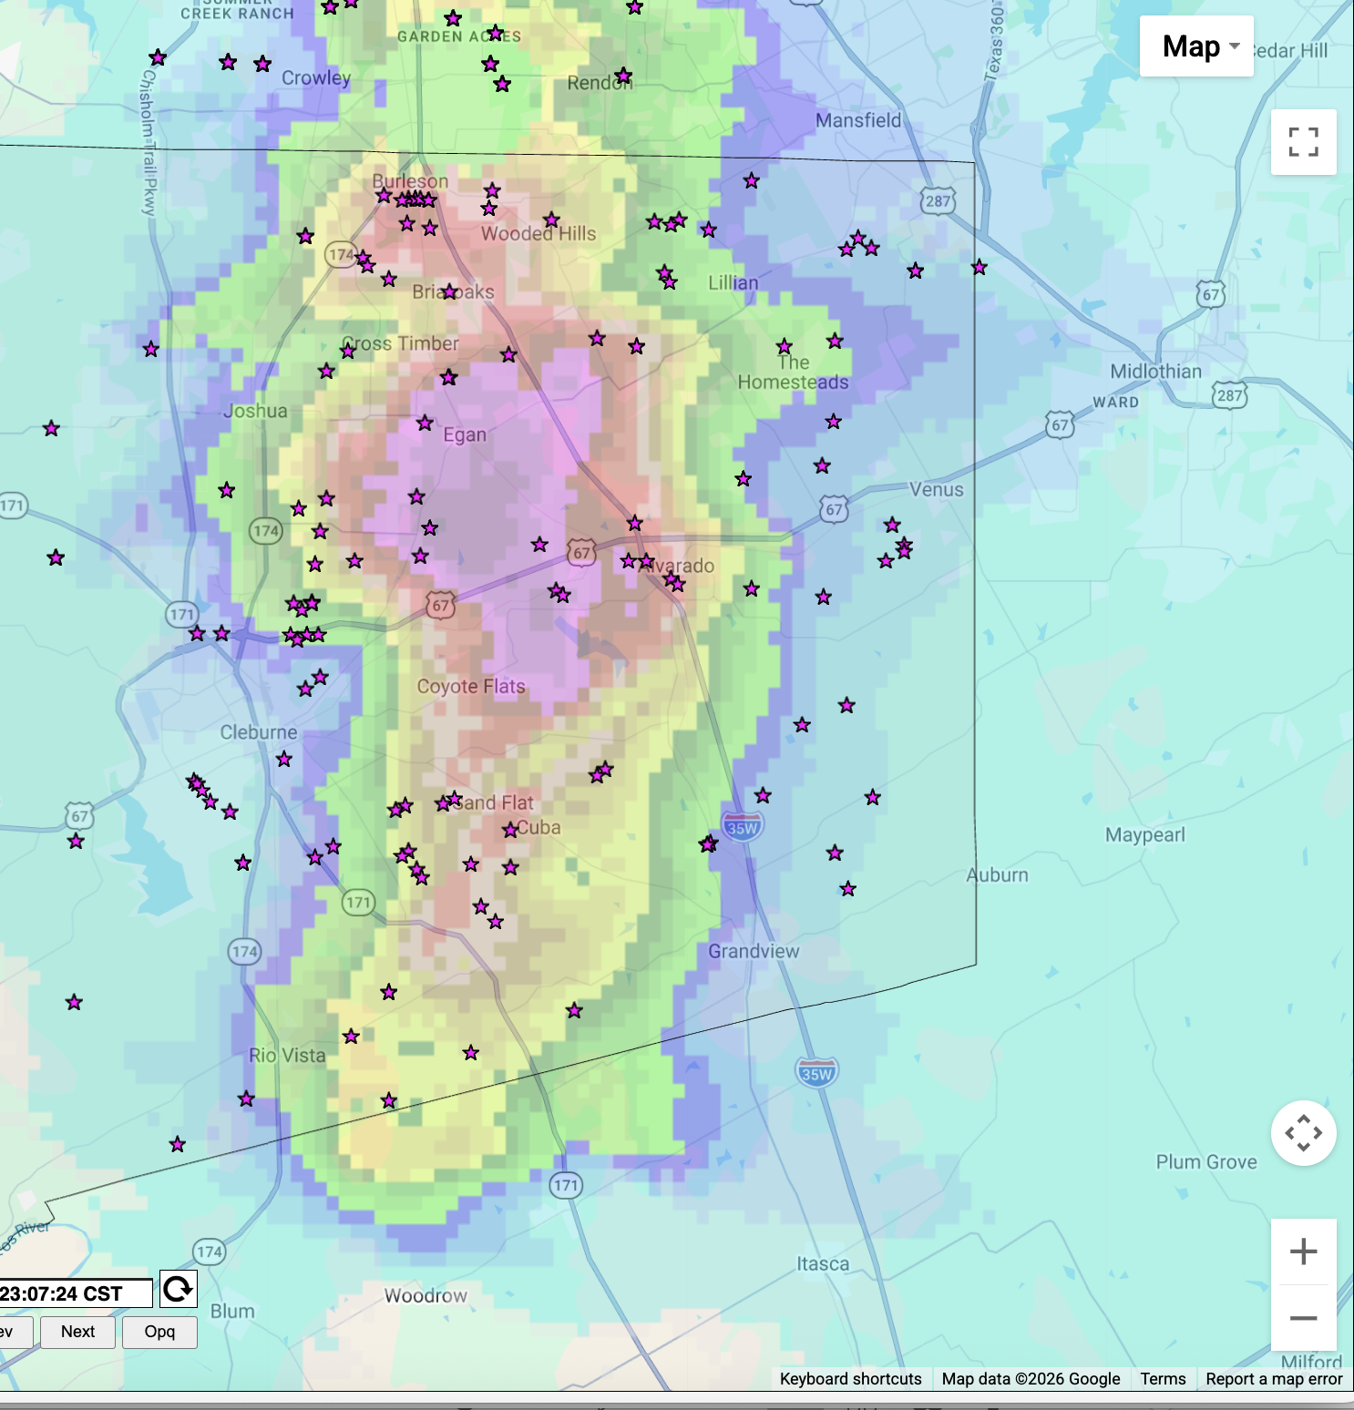
1 Hour Rainfall Accumulation
2.5 inches

Slide 8
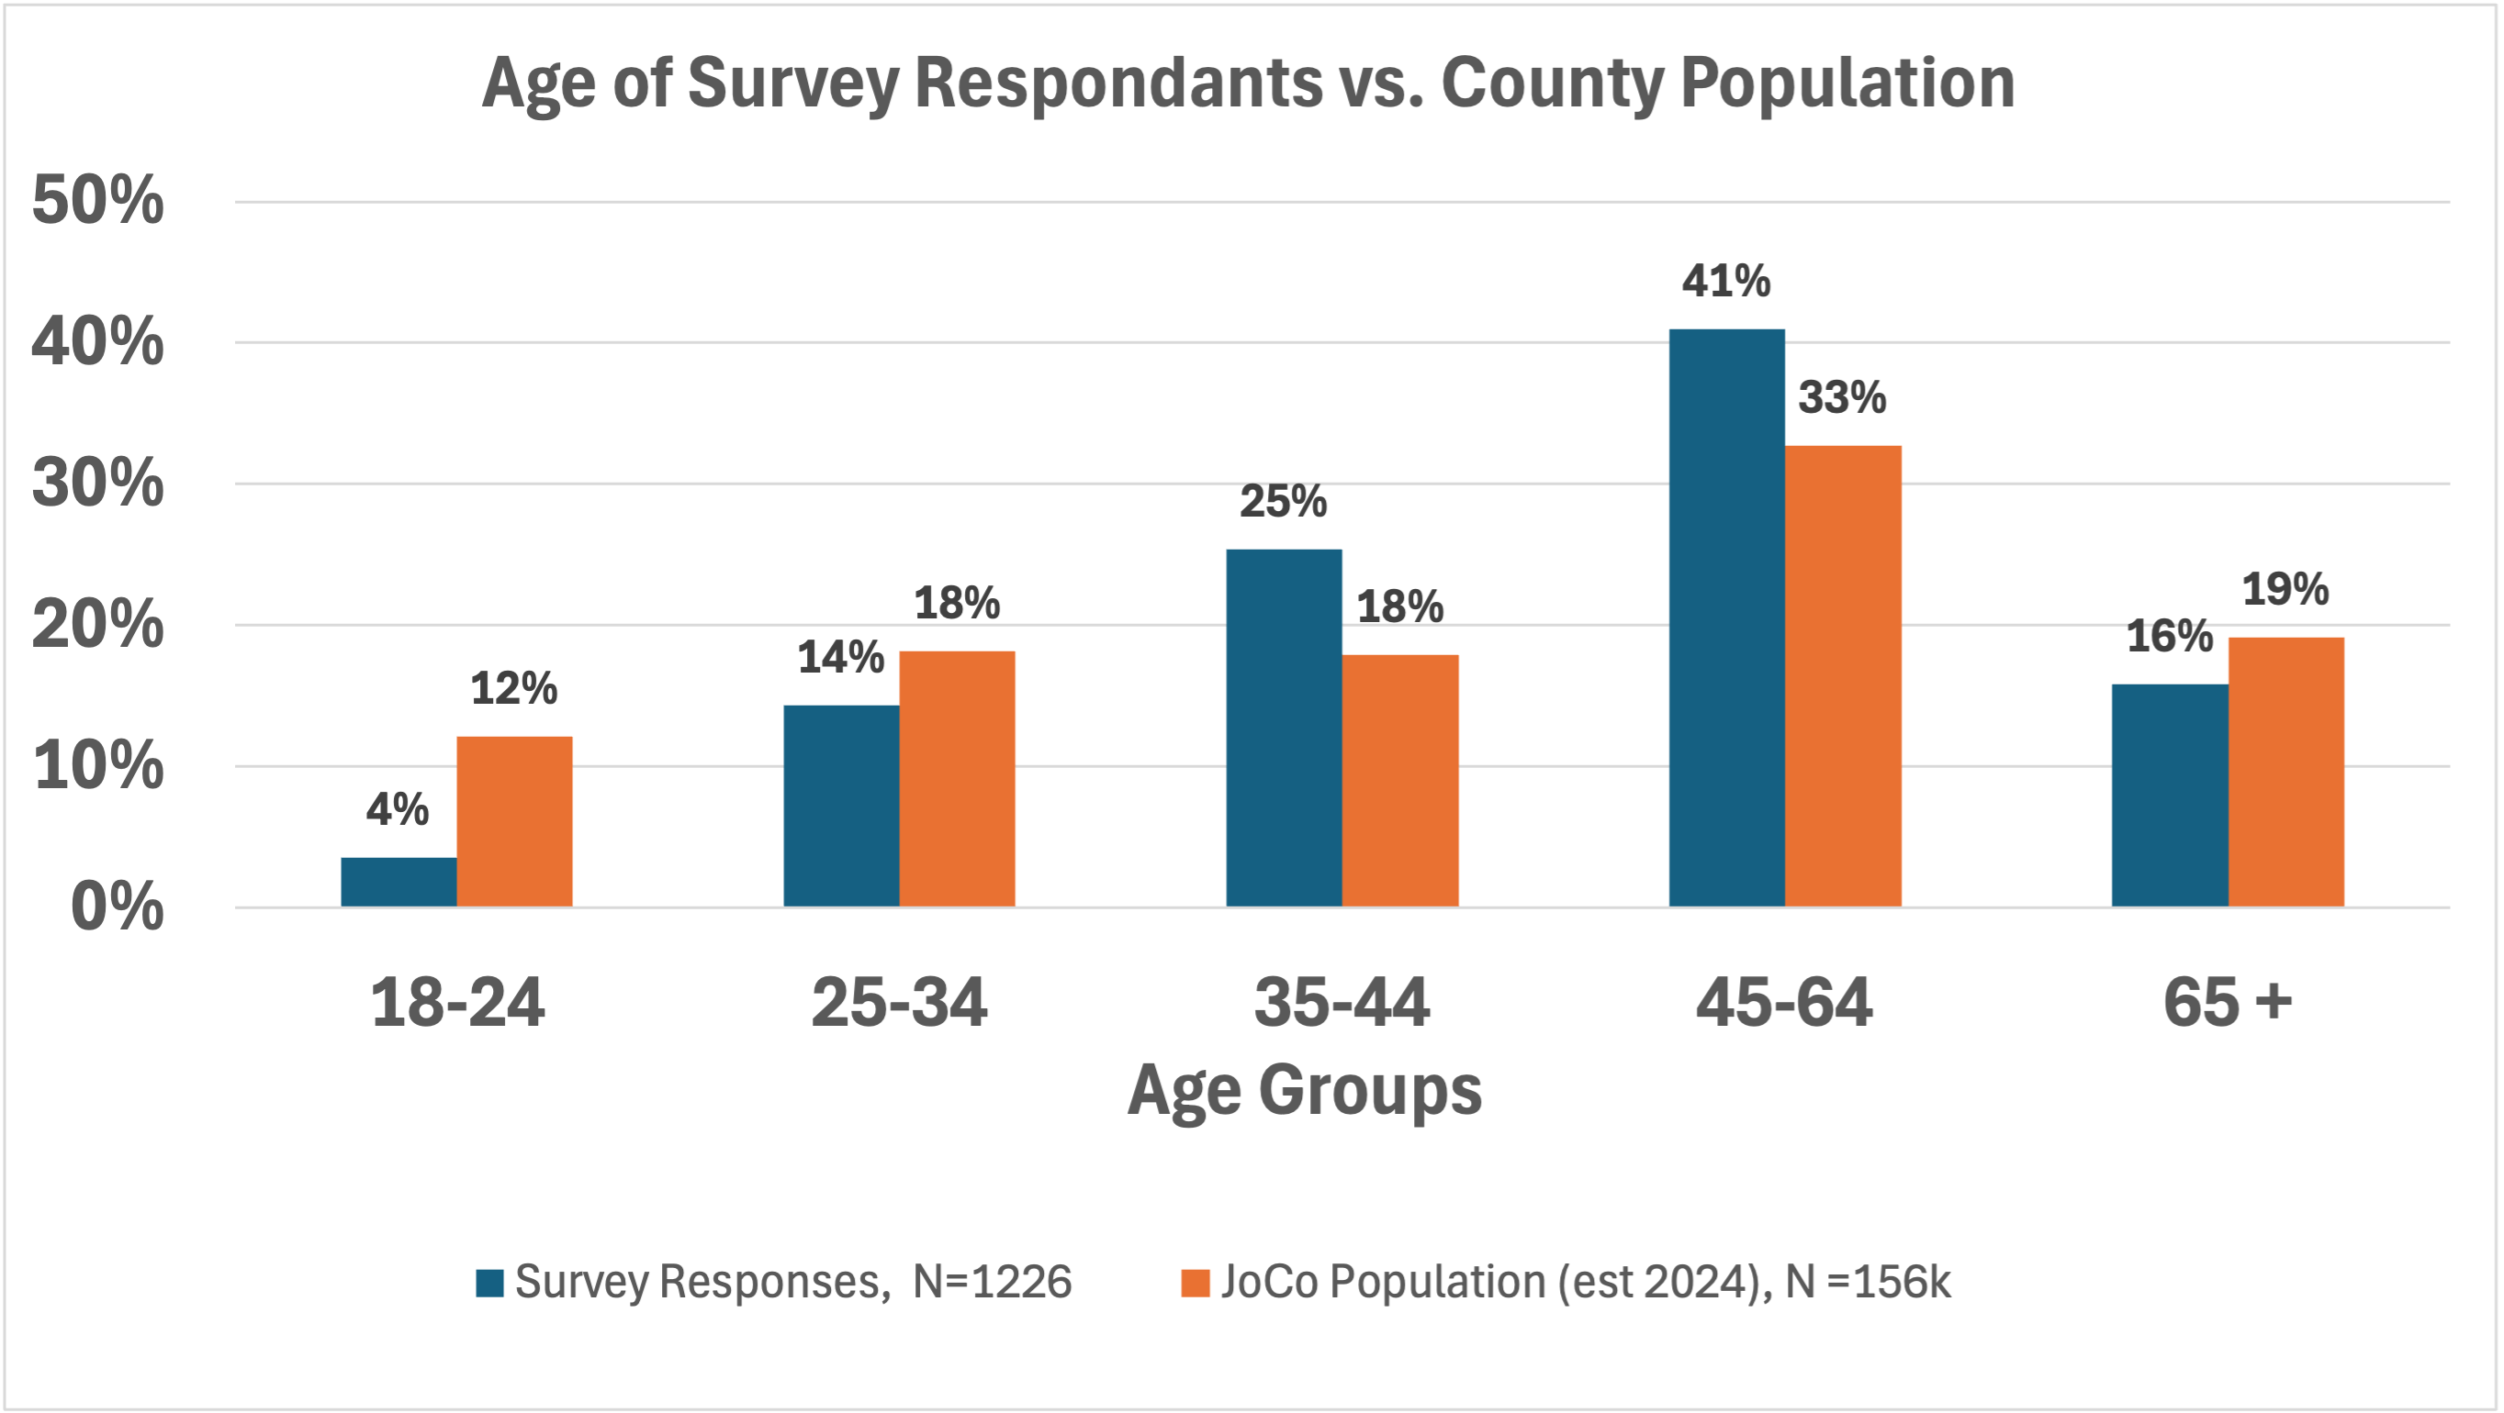
Public Response Surveys
On-line survey disseminated through social media
Awareness/Experiences with Flash Floods
Who and how people get weather info
Ideas for improvements in alerting
1,226 responses

Slide 9
Flood Experience: Respondents are Flood Savvy
57% know of Low Water Crossings (LWC)
Of those, 81% know because they have seen floods at LWCs
Survey asks for location…they mostly match known LWCs

Slide 10
The HOW and the WHO of Weather Information Use
Respondents were asked about 23 weather sources and channels
Usage patterns reveal two types of users: Digital First & Traditionalists
User types have similar sources, but differ in their channel usage
Percent of each user group that uses a source or channel based on Latent Class Analysis
*
Notes:
he probability that someone in each group uses A product

Slide 11
Suggestions for Improvements in Alerting

Slide 12
Next Steps
Flash Flood Risk
Identify Flood Risk Thresholds for LWC
Test notification of stakeholders
Addition of Flood Sensors
Public Communications
Target multiple channels for risk communication
CASA can help with more geographically specific alerts.

Slide 13
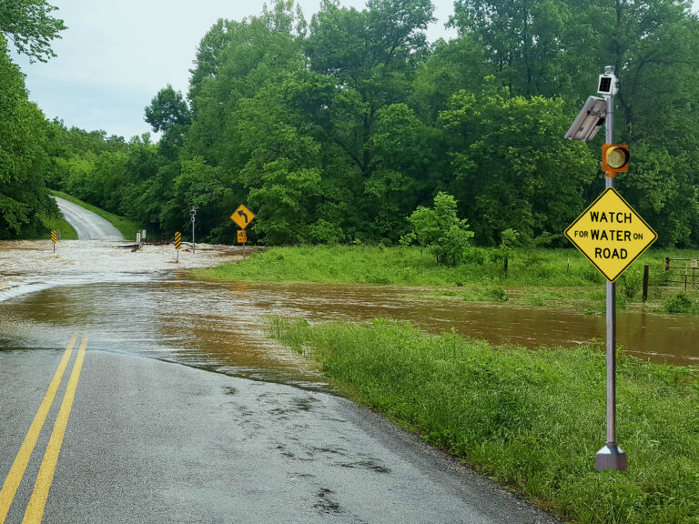
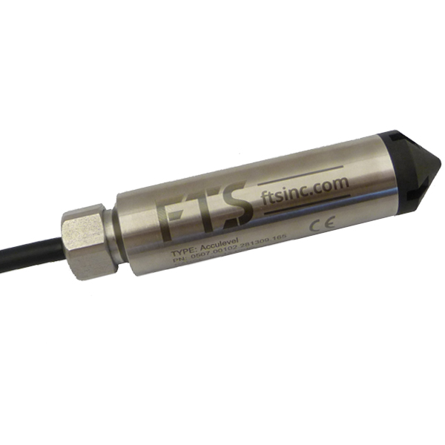
Incorporation of Pressure Transducers To Key LWCs
(and possible automated signage)

